Slide 1


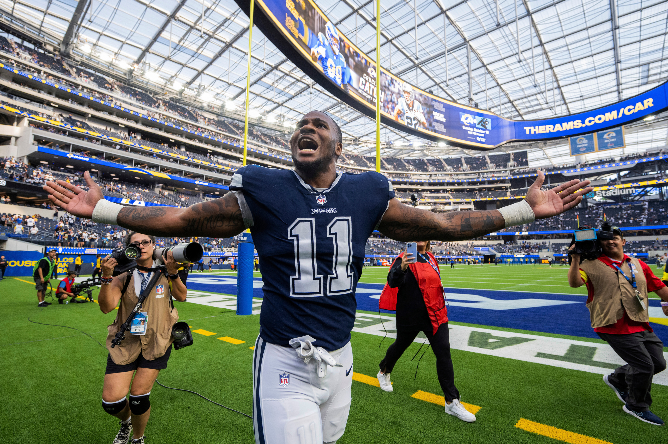



DALLAS COWBOYS ALUMNI EVENT
CoAst to Coast
CESAR PINEDA, MAX MCAULIFF
& Tally Theder

Slide 2

Agenda
Objectives
Project Pitch Details
Target Market & Marketing Strategy
Overall Timeline
Sponsorship Timeline
Financials
Philanthropy Idea

Slide 3
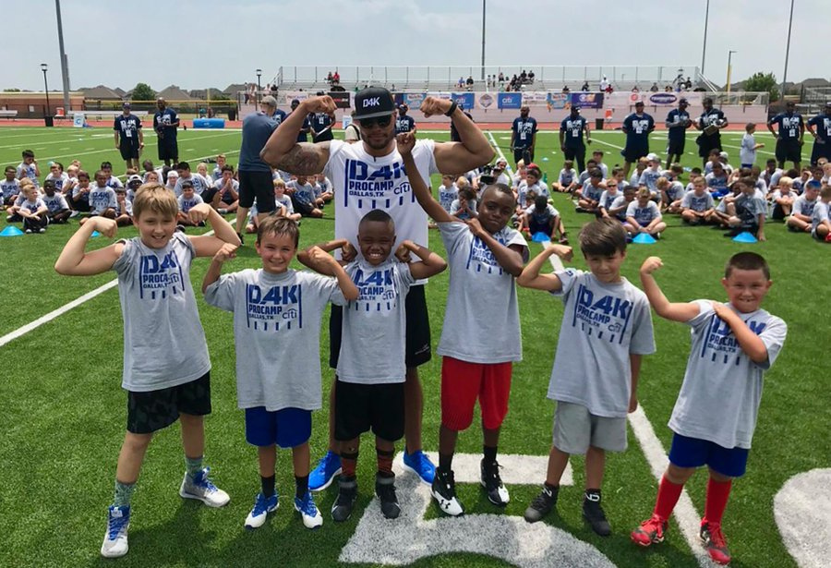
  $3 million+ revenue annual event
  Create a unique experience for fans.
  Sponsors brand awareness & Synergy
  Engage a new demographic of fans (women, kids)
  Philanthropy
Objectives

Slide 4


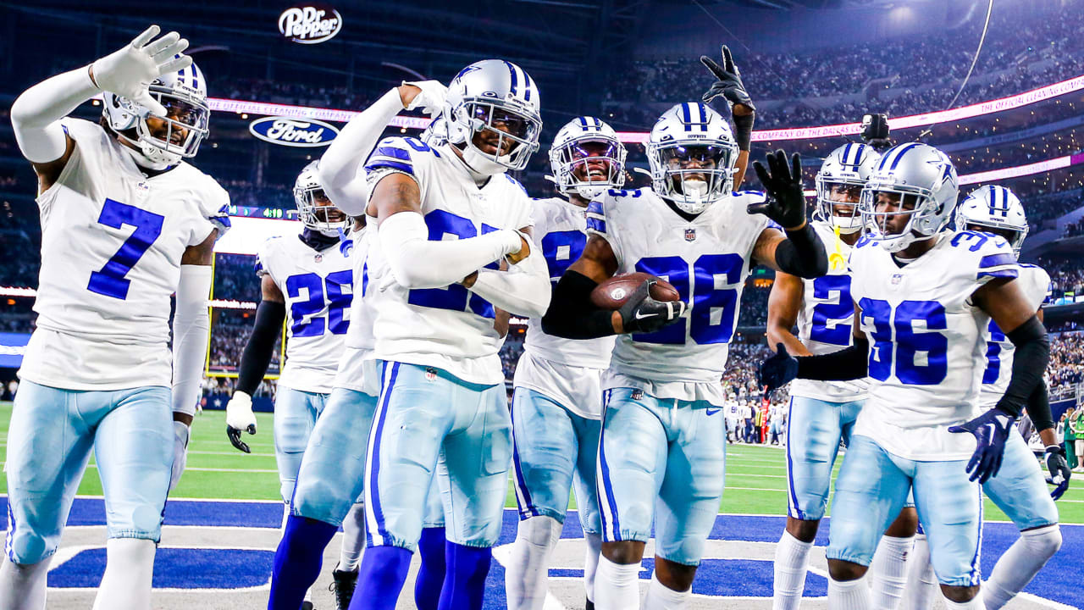

Project Pitch: Dallas Cowboys Alumni Network
What: Field Day of Events
Who: Former Dallas Cowboy alumni, kids & general public
  Fun Run around the venues
  Field Day activities (Frisbee, Cornhole, etc.)
  Field goal where a kid Kicks
  Dallas Cowboys alumni kickball game
  Autograph and Photo opportunities
When: June
Where: AT&T Stadium Arlington, TX

Slide 5
Timeline
One Year Prior:
Market Research & Planning: Conduct thorough market research on the Dallas Fort Worth area to understand audience preferences. Create a detailed event plan outlining activities, logistics, and marketing strategies.
Sponsorship Acquisition: Begin reaching out to potential sponsors such as The Star District, Ford, PepsiCo, Legends Hospitality, and Fanatics for partnerships and funding.
Six Months Prior:
Finalize Sponsorships: Close deals with sponsors and define the terms of the partnerships.
Marketing Campaign Launch: Begin promoting the event on TikTok, Facebook, Instagram, and through targeted emails to the specified demographics.
Alumni Network & All Pro Dad Events: Host networking events with UNT alumni and organize keynote speakers with former Dallas Cowboys players for Title 1 schools.
One Month Prior:
Ticket Sales Launch: Start selling tickets for the event. Offer individual tickets at $100 each, package deals at $500, and group/family tickets with customized branding and meet-and-greet opportunities with players.
Flyer Distribution & Social Media Blitz: Launch a widespread distribution of flyers and intensify the social media campaign to build anticipation.
Day of the Event:
Fun Run & Field Day Activities: Commence the day with the fun run around the venues followed by various field day activities such as Frisbee, Cornhole, and a field goal kicking event for kids.
Alumni Kickball Game & Autograph Sessions: Conduct the Dallas Cowboys alumni kickball game and provide autograph and photo opportunities with former players.
Raffle Ticket Sale: Sell raffle tickets (pack of 50 for $100) with a portion of proceeds dedicated to local high schools in the Dallas Fort Worth area.
Throughout the Planning Process:
Community Engagement: Maintain a consistent focus on community outreach, building relationships with local high schools, and establishing ties with non-profit organizations.
Philanthropic Efforts: Ensure a portion of proceeds and fundraising efforts consistently benefit local high schools and the community.

Slide 6
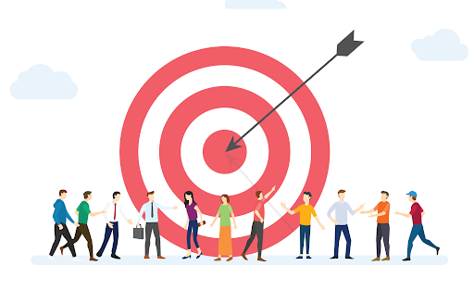
Target Audience:
  Dallas Fort Worth Families
  Dallas Fort Worth Non-Profits
  Title 1 schools
Target Sponsors:
  The Star District
  Dallas Cowboys & Legends established partners
  Dallas Cowboys alumni
Target Market

Slide 7





MARKETING

Slide 8
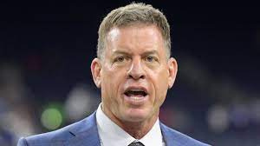
Troy Aikman: Marketing Strategy
  12 seasons with the Cowboys
  former quarterback
  56 years old
  well-known former player
  can speak at the event

Slide 9
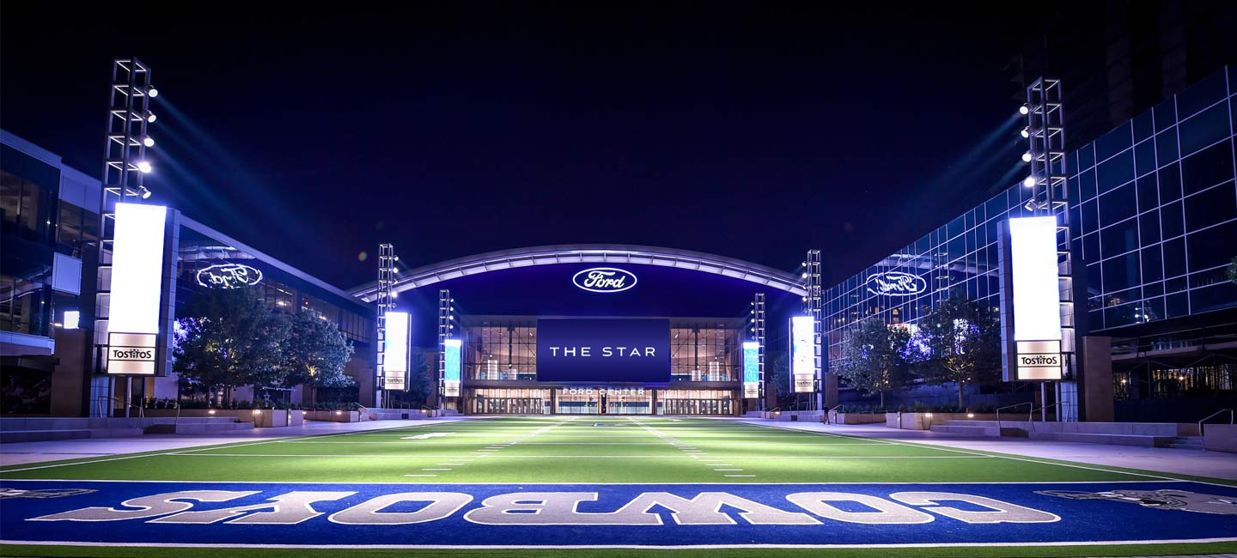
Sponsorships
Car sponsor: Ford
Soft Drink, Tea, Snack: PepsiCo
Food: Legends Hospitality
Apparel: Fanatics - Cowboys Merchandise
Nike can sell t-shirts for $15 each
Activations:
Prior to Launch:
  Alumni Network Event w/ UNT
  All Pro Dad keynote speakers w/ alumni for Title 1 Schools
  Alumni Signing Events
Prior To Kickoff:
  Launch Flyers and Social Media Campaign
  The Star District Marketing Campaign

Slide 10
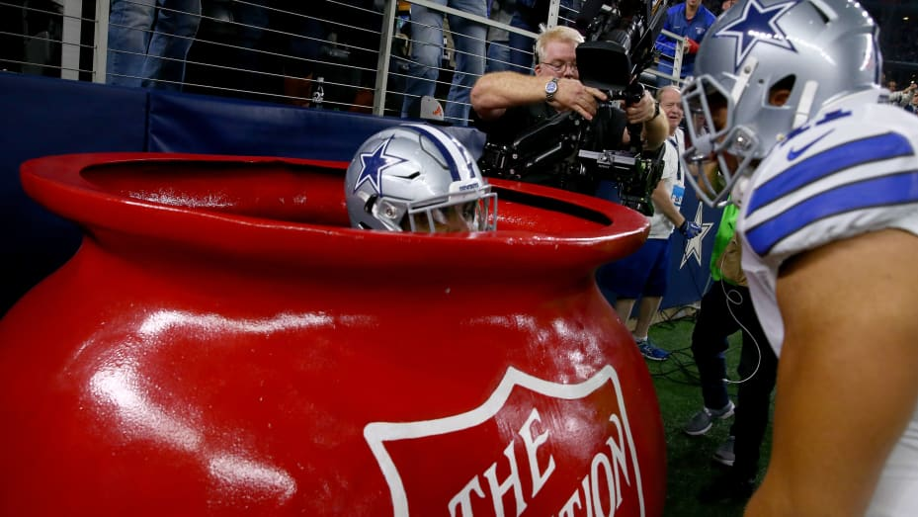
Financials
How much for a school (college/university) to participate: $2,000
How much for single person to buy seats: $100
How much for ticket packages: $500
Family/ Group Tickets
Tailored for companies or large groups.
Exclusive designated area for the group with catering options available.
Meet-and-greet opportunities with former Cowboy players for the group.
Customized branding or signage in the designated area.
How much for raffle tickets: pack of 50 for $200

Slide 11
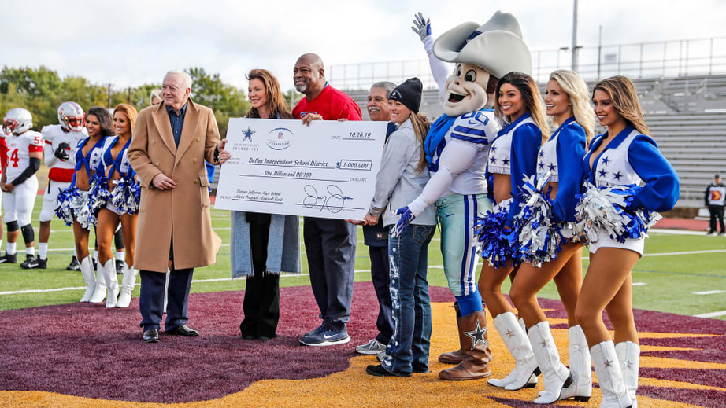
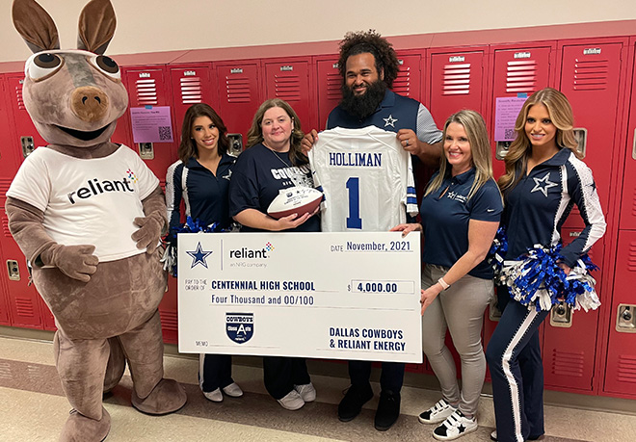
Philanthropy
  10% of proceeds will be donated to local high schools in the Dallas Fort Worth area
  Grow community outreach
  Build relationships with local high schools

Slide 12
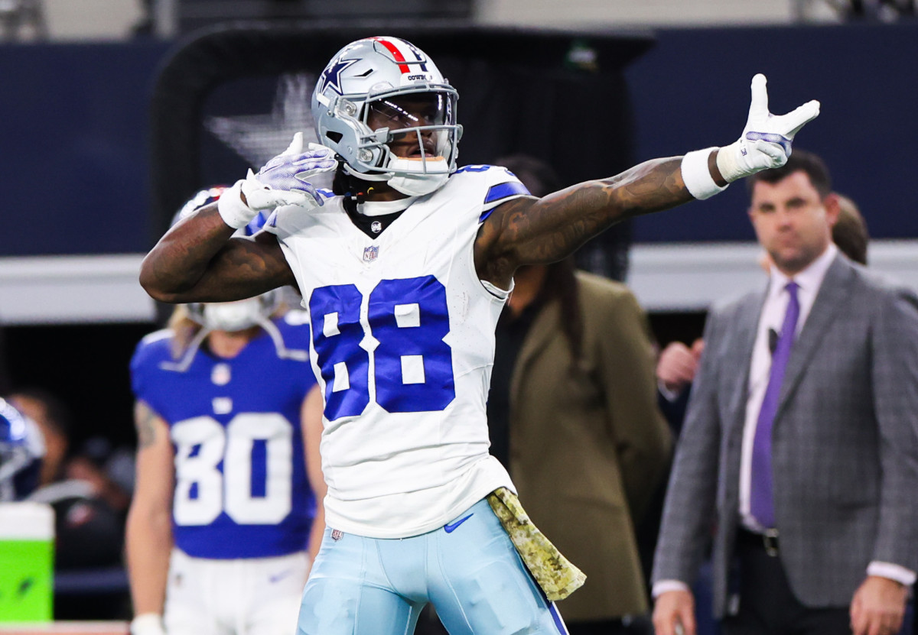
Conclusion
  Project success will be based on how many people buy tickets and sponsorship deals
  Provide a new and exciting way for people to interact with alumni players
  Watch a softball game of different alumni at the end of the day

Slide 13

Questions???
THANK YOU!!!

